Slide 1
DAO-CP (proposed)
DTD
OnlineCP
DAO-CP (proposed)
DTD
OnlineCP
Full-CP
DAO-CP (proposed)
DTD
OnlineCP
Full-CP
Video (Rank 10)
Video (Rank 20)
Video (Rank 30)
Video (Rank 40)
Video (Rank 50)
Synthetic (Rank 10)
Synthetic (Rank 20)
Synthetic (Rank 30)
Synthetic (Rank 40)
Synthetic (Rank 50)
graph_laptop
intro_desktop
lecture_desktop
table_laptop
text_laptop
Stock (Rank 10)
Stock (Rank 15)
Stock (Rank 20)
Stock (Rank 25)
Stock (Rank 30)
Hall (Rank 10)
Hall (Rank 15)
Hall (Rank 20)
Hall (Rank 25)
Hall (Rank 30)
Korea (Rank 10)
Korea (Rank 15)
Korea (Rank 20)
Korea (Rank 25)
Korea (Rank 30)
Notes:
', 'intro_desktop', 'lecture_desktop', 'table_laptop', 'text_laptop'

Slide 2
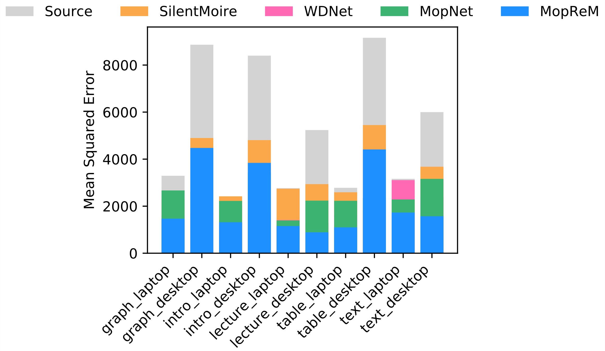
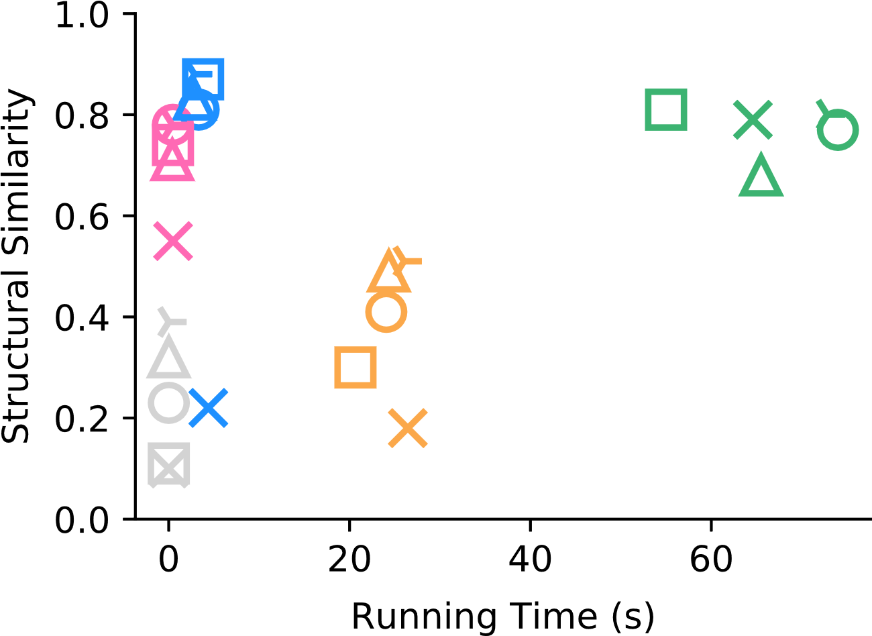
graph_laptop
intro_desktop
lecture_desktop
table_laptop
text_laptop

